Slide 1
Module 2.0
Linear Data Structure: Linked List

Slide 2
Memory Allocation & Deallocation for Linked List

Slide 3
Memory Allocation
There are two types of Memory Allocation
Compile Time or Static Allocation
Runtime or Dynamic Allocation

Slide 4
Compile Time or Static Allocation
Memory allocated to the program element
at the start of the program.
Static Memory is allocated for declared variables by the compiler
Memory allocated
is fixed and determined by the compiler at compile time.
Eg- float a[5] ,
allocation of 20 bytes to the array, i.e. 5*4 bytes

Slide 5
Compile Time or Static Allocation
Inefficient Use of Memory-
Can cause under utilization of memory in case of over allocation
That is if you store less number of elements than the number for elements which which you have declared memory.
Rest of the memory is wasted, as it is not available to other applications.

Slide 6
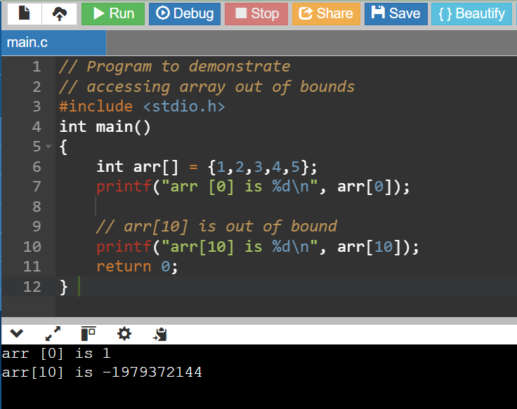
Compile Time or Static Allocation
Inefficient Use of Memory-
Can cause Overflow in case of under allocation

Slide 7
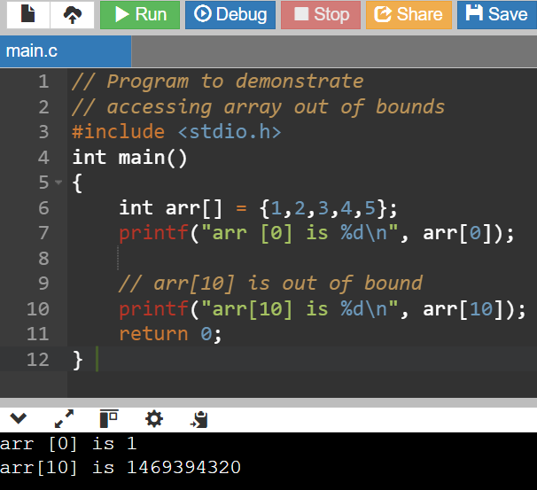
Compile Time or Static Allocation
Garbage Values on Re runs

Slide 8
Compile Time or Static Allocation
Inefficient Use of Memory-
Can cause Overflow in case of under allocation
For float a[5];
No bound checking in C for array boundaries, if you are entering more than fives values,
It will not give error but when these extra element will be accessed, the values will not be available.

Slide 9
Compile Time or Static Allocation
No reusability of allocated memory
Difficult to guess the exact size of the data at the time of writing the program

Slide 10
Runtime or Dynamic Allocation
All Linked Data Structures are preferably implemented through dynamic memory allocation.
Dynamic data structures provide flexibility in adding, deleting or rearranging data objects at run time.
Managed in C through a set of library functions:
malloc()
Calloc()
free()
Realloc()

Slide 11
Runtime or Dynamic Allocation
Memory allocation done at the time of execution(run time)
Memory space required by Variables is calculated and allocated during execution
Get Required chunk of memory at Run time or As the need arises
Best Suited –
When we do not know the memory requirement in advance, which is the case in most of the real life problems.

Slide 12
Runtime or Dynamic Allocation
Efficient use of Memory
Additional Space can be allocated at run time.
Unwanted Space can be released at run time.
Reusability of Memory space

Slide 13
The malloc() fn
Allocates a block of memory in bytes
The user should explicitly give the block size needed.

Slide 14
The malloc() fn
Request to the RAM of the system to allocate memory,
If request is granted returns a pointer to the first block of the memory
If it fails, it returns NULL

Slide 15
The malloc() fn
The type of pointer is Void, i.e. we can assign it any type of pointer.
Available in header file alloc.h or stdlib.h

Slide 16
The mallloc() fn
Syntax-
ptr_var=(type_cast*)malloc(size)

Slide 17
The mallloc() fn
Syntax-
ptr_var=(type_cast*)malloc(size)
ptr_var = name of pointer that holds the starting address of allocated memory block
type_cast* = is the data type into which the returned pointer is to be converted
Size = size of allocated memory block in bytes

Slide 18
The mallloc() fn
Eg-
int *ptr;
ptr=(int *)malloc(10*sizeof(int));

Slide 19
The mallloc() fn
Eg-
int *ptr;
ptr=(int *)malloc(10*sizeof(int));
Size of int=2bytes
So 20 bytes are allocated,
Void pointer is casted into int and assigned to ptr

Slide 20
The mallloc() fn
Eg-
char *ptr;
ptr=(char *)malloc(10*sizeof(char));

Slide 21
The mallloc() fn- Usage in Linked List
Eg-
struct student;
{
int roll_no;
char name[30];
float percentage;
};
struct student *st_ptr;
st_ptr=(struct student *)malloc(10*sizeof(struct student));

Slide 22
The callloc() fn
Similar to malloc
It neds two arguments as against one argument in malloc() fn
Eg-
int *ptr;
ptr=(int *)calloc(10,2));
1st argument=no of elements
2nd argument=size of data type in bytes

Slide 23
The callloc() fn
Available in header file alloc.h or stdlib.h

Slide 24
Malloc() vs callloc() fn
Initialization:
malloc() doesn’t initialize the allocated memory.
If we try to access the content of memory block(before initializing) then we’ll get segmentation fault error(or garbage values).
calloc() allocates the memory and also initializes the allocated memory block to zero.
If we try to access the content of these blocks then we’ll get 0.

Slide 25
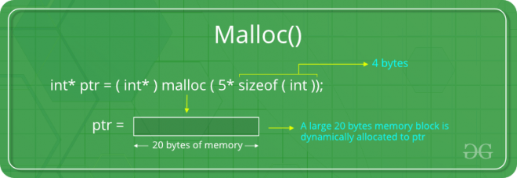
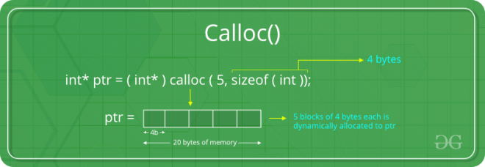
Malloc() vs callloc() fn
Malloc
allocate a single large block of memory with the specified size.
Calloc
allocate multiple blocks of memory
dynamically allocate the specified number of blocks of memory of the specified type.

Slide 26
The free() fn
Used to deallocate the previously allocated memory using malloc or calloc() fn
Syntax-
free(ptr_var);
ptr_var is the pointer in which the address of the allocated memory block is assigned.
Returns the allocated memory to the system RAM..

Slide 27
What happens when you don’t free memory after using malloc()

Slide 28
What happens when you don’t free memory after using malloc()
The memory allocated using malloc() is not de-allocated on its own.
So, “free()” method is used to de-allocate the memory.
But the free() method is not compulsory to use.

Slide 29
What happens when you don’t free memory after using malloc()
If free() is not used in a program
the memory allocated using malloc() will be de-allocated
after completion of the execution of the program
(included program execution time is relatively small and the program ends normally).

Slide 30
What happens when you don’t free memory after using malloc()
Still, there are some important reasons to free() after using malloc():
Use of free after malloc is a good practice of programming.
There are some programs like a digital clock, a listener that runs in the background for a long time and there are also such programs which allocate memory periodically.

Slide 31
What happens when you don’t free memory after using malloc()
Still, there are some important reasons to free() after using malloc():
In these cases, even small chunks of storage add up and create a problem.
Thus our usable space decreases.
This is also called “memory leak”.
It may also happen that our system goes out of memory if the de-allocation of memory does not take place at the right time.

Slide 32
Memory Leak ?
A memory leak is a type of resource leak
that occurs when a computer program incorrectly manages memory allocations
in a way that memory which is no longer needed is not released

Slide 33
The realloc() fn
To resize the size of memory block, which is already allocated using malloc.
Used in two situations:
If the allocated memory is insufficient for current application
If the allocated memory is much more than what is required by the current application

Slide 34
The realloc() fn
Syntax-
ptr_var=realloc(ptr_var,new_size);
ptr_var is the pointer holding the starting address of already allocated memory block.
Available in header file<stdlib.h>
Can resize memory allocated previously through malloc/calloc only.

Slide 35
Eg of mallloc() fn
#include <stdio.h>
#include <string.h>
#include <stdlib.h>
int main()
{
char *mem_allocation;
mem_allocation = (char *) malloc( 20 * sizeof(char) );
if( mem_allocation == NULL )
{
printf("Couldn't able to allocate requested memory\n");
}
else
{
strcpy( mem_allocation,"fresh2refresh.com");
}

Slide 36
Eg of mallloc() fn
printf("Dynamically allocated memory content : "%s\n", mem_allocation );
mem_allocation=realloc(mem_allocation,100*sizeof(char));
if( mem_allocation == NULL )
{
printf("Couldn't able to allocate requested memory\n");
}
else
{
strcpy( mem_allocation,"space is extended upto 100 characters");
}
printf("Resized memory : %s\n", mem_allocation );
free(mem_allocation);
}

Slide 37
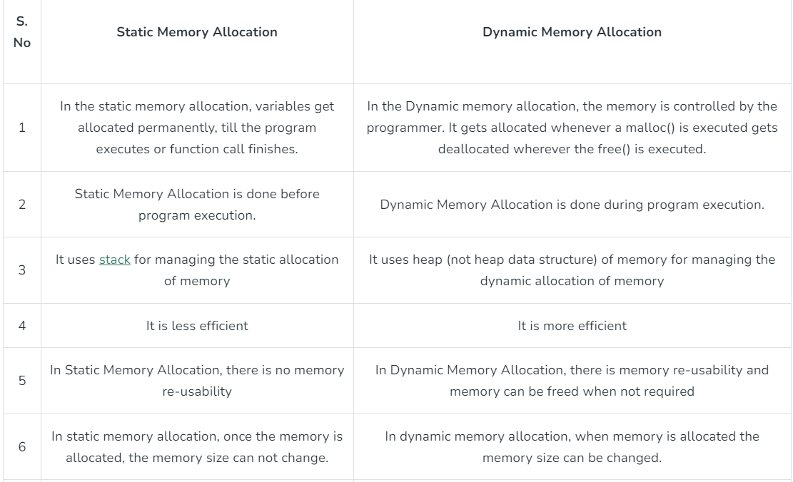

Slide 38
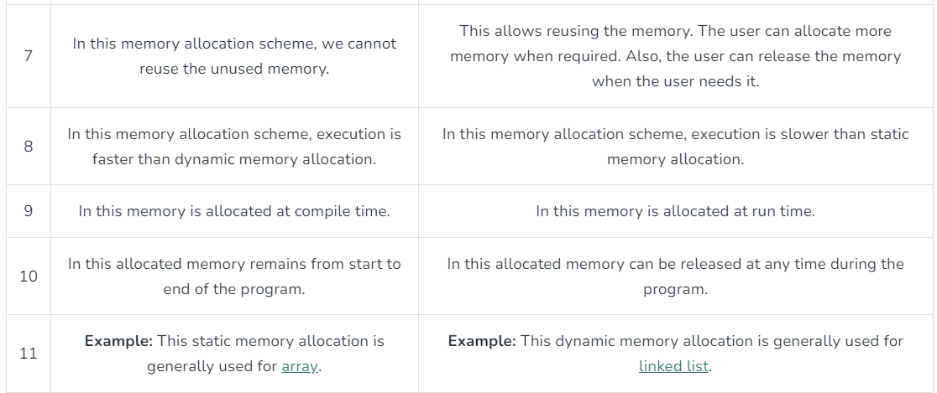

Slide 39
Pointers and arrays
Allocating individual integers isn't all that useful either. But malloc() can also allocate arrays. We will discuss the similarity of pointers and arrays in class, and the textbook discusses this in section 3.13. But essentially, a pointer can be used as an array, and you can index it just like an array, as long as it is pointing to enough memory. The following example demonstrates this:
int *ip; ip = (int *) malloc( sizeof(int)*10 ); // allocate 10 ints ip[6] = 42; // set the 7th element to 42 ip[10] = 99; // WRONG: array only has 10 elements (this would corrupted memory!)

Slide 40
Which part of the memory is allocated when static memory allocation is used, for int,char,float,arrays,struct,unions…..? Which part of the memory is allocated when malloc and calloc are called for any variable?
??

Slide 41
Stack
Basic type variables such as int, double, etc, and complex types such as arrays and structs. These variables are put on the stack in C.
There is a limit (varies with OS) on the size of variables that can be stored on the stack.
This is not the case for variables allocated on the heap
https://sites.ualberta.ca/dept/chemeng/AIX-43/share/man/info/C/a_doc_lib/aixprggd/genprogc/sys_mem_alloc.htm

Slide 42
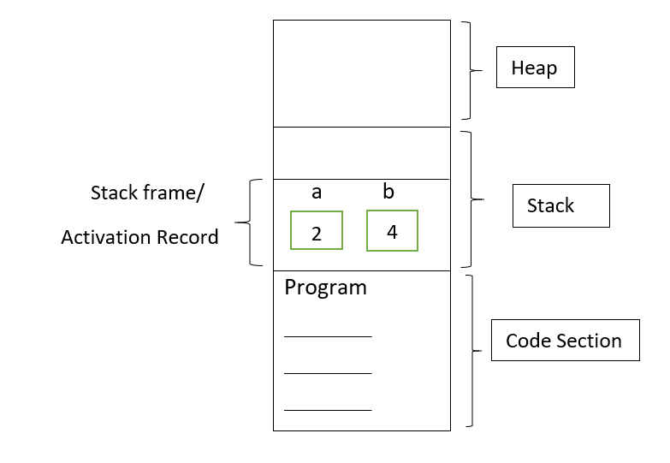
Stack
#include <iostream>
using namespace std;
// Driver Code
void main()
{
int a; // 2 bytes
long b; // 4 bytes
}
https://www.geeksforgeeks.org/static-and-dynamic-memory-allocation-in-c/

Slide 43
Heap
The heap is a region of your computer's memory that is not managed automatically for you, and is not as tightly managed by the CPU.
It is a more free-floating region of memory (and is larger).
Dynamic memory allocation functions allocates memory from the heap.

Slide 44
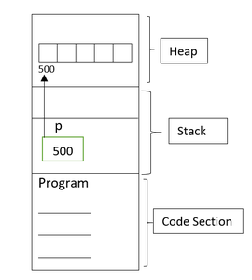
Stack
#include <iostream>
using namespace std;
// Driver Code
void main()
{
int* p; // 2 bytes
P = (int*)malloc(5 * sizeof(int));
}
https://www.geeksforgeeks.org/static-and-dynamic-memory-allocation-in-c/

Slide 45
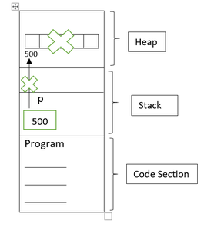
Stack
#include <iostream>
using namespace std;
// Driver Code
void main()
{
int* p; // 2 bytes
P = (int*)malloc(5 * sizeof(int));
free(p);
p=NULL;
}
https://www.geeksforgeeks.org/static-and-dynamic-memory-allocation-in-c/

Slide 46
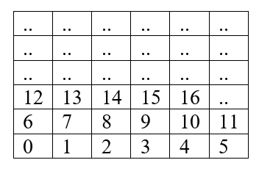
Memory is divided into smaller addressable units called bytes.
Assume that these are small boxes as bytes.
Each byte has its own address as per the below table. For example: 0, 1, 2, 3, 4, 5, 6, etc.

Slide 47
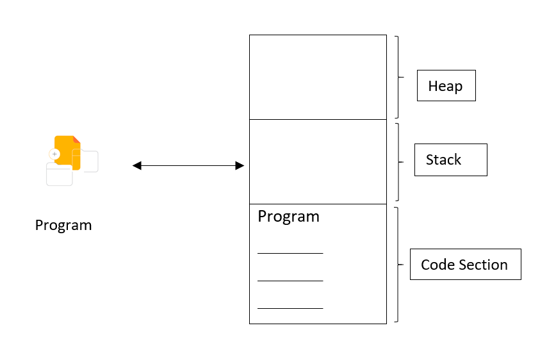
The Memory is divided into three sections.
Heap Memory
Stack Memory
Code Section
How program uses memory?

Slide 48
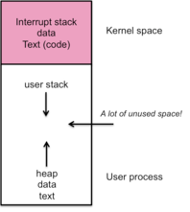
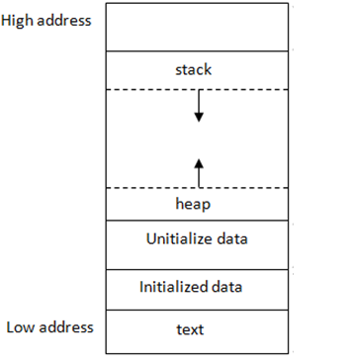
Stack and Heap
Stack and Heap both stored in the computer's RAM .

Slide 49
Heap
To allocate memory on the heap, you must use malloc() or calloc(), which are built-in C functions.
Deallocate memory on heap using free
If you fail to do this, your program will have what is known as a memory leak. That is, memory on the heap will still be set aside (and won't be available to other processes).

Slide 50
Stack vs Heap
Heap –
You must manage memory (you're in charge of allocating and freeing variables)
The heap does not have size restrictions on variable size (apart from the obvious physical limitations of your computer).
Heap memory is slightly slower to be read from and written to, because pointers are used to access memory on the heap.
Variables can be resized using realloc()
variables can be accessed globally
Stack –
Don't have to explicitly de-allocate variables
The stack has size limits
very fast access
variables cannot be resized
local variables only
https://gribblelab.org/CBootCamp/7_Memory_Stack_vs_Heap.html

Slide 51
Stack
Stack resident variables are:
created (“pushed on to”) the stack when a basic block that contains them (i.e. function) is activated and
disappear from (“popped off”) the stack when the function is done
(Those areas of memory that had been used by variables when a basic block was activated may then be overwritten after exit from the block.)
stack memory is more limited, i.e. there is less of it compared to heap memory
http://citeseerx.ist.psu.edu/viewdoc/download;jsessionid=13D3E255880D543426E53785A6A7895F?doi=10.1.1.705.51&rep=rep1&type=pdf

Slide 52
Heap
Heap resident variables include:
variables declared outside all functions (globals)
variables declared inside basic blocks that are declared static
memory areas dynamically allocated at run time with malloc( )
Storage for declared heap resident variables is:
assigned at the time a program is loaded, and
remains assigned for the life of a program

Slide 53
Linked List

Slide 54
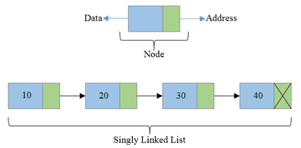
Linked Lists
Linear Collection of data elements called Nodes
Linear order is given by means of pointers.

Slide 55
Linked Lists
Each node may be divided into atleast two fields for :
Storing Data
Storing Address of next element.

Slide 56
Linked Lists
The Last node’s Address field contains Null rather than a valid address.
It’s a NULL Pointer and indicates the end of the list.

Slide 57
Comparison between Array and Linked List

Slide 58
Advantages of Linked List
Linked are Dynamic Data Structures
Grow and shrink during execution of the program
Efficient Memory Utilization
As memory is not preallocated.
Memory can be allocated whenever required and deallocated when not needed.
Insertion and deletions are easier and efficient
Provide flexibility in inserting a data item at a specified position and deletion of a data item from the given position
Many complex applications can be easily carried out with linked lists

Slide 59
Disadvantages of Linked List
Access to an arbitary data item is little bit cumbersome and also time consuming
More memory
If the number of fields are more, then more memory space is needed.

Slide 60
Advantages of Arrays
Simple to use and define
Supported by almost all programming languages
Constant access time
Array element can be accessed a[i]
Mapping by compiler
Compiler maps a[i] to its physical location in memory.
This mapping is carried out in constant time, irrespective of which element is accessed

Slide 61
Arrays suffer from some severe limitations
Disadvantages of Arrays
Static Data Structure-
Size of an array is defined at the time of programming
Insertion and Deletion is time consuming
Requires Contiguous memory

Slide 62
Types of Linked List
Singly Linked List
Doubly Linked List
Circular Linked List

Slide 63
Singly Linked List
All nodes are linked in sequential manner
Linear Linked List
One way chain
It has beginning and end

Slide 64
Singly Linked List
Problem-
The predecessor of a node cannot be accessed from the current node.
This can be overcome in doubly linked list.

Slide 65
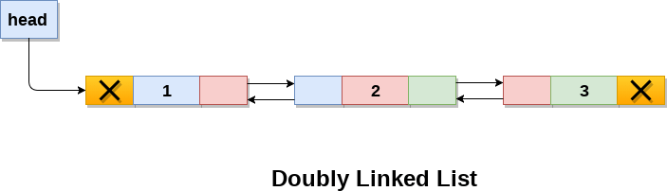
Doubly Linked List
Linked List holds two pointer fields
Addresses of next as well as preceding elements are linked with current node.
This helps to traverse in both Forward or Backward direction

Slide 66
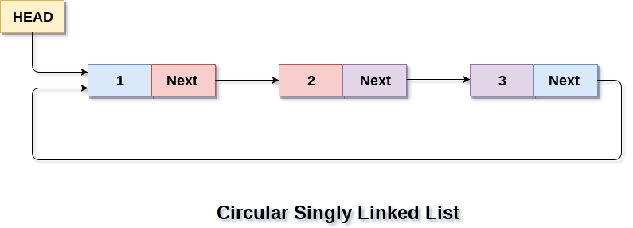
Circular Linked List
The first and last elements are adjacent.
A linked list can be made circular by
Storing the address of the first node in the link field of the last node.

Slide 67
Linked List Operations
Creation
Insertion
Deletion
Traversal
Searching

Slide 68
Implementation of Linked Lists
Structures in C are used to define a node
Address of a successor node can be stored in a pointer type variable

Slide 69
Linked Lists
Struct Basics
Struct Syntax
Struct examples
Pointer to structure
Sample Programs for Pointer to structures
Initialization of Pointers to Structures

Slide 70
Linked Lists
Information field
struct node
{
int info;
struct node *link;
}
Pointer that points to the structure itself,
Thus Linked List.

Slide 71
Singly Linked List

Slide 72
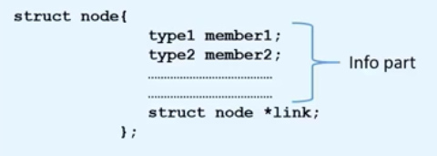
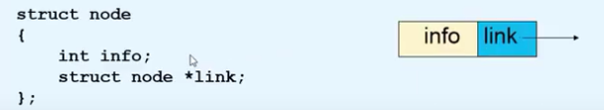

Creation of a new node

Slide 73
Creation of a new node
New node=temp
struct node *tmp;
tmp= (struct node *) malloc(sizeof(struct node));
tmp->info=data;
tmp->link=NULL;

Slide 74
Creating a Linked List
create_list(int data)
{
struct node *q,*tmp;
tmp= (struct node *) malloc(sizeof(struct node));
tmp->info=data;
tmp->link=NULL;
if(start==NULL) /*If list is empty */
{
start=tmp;
}
else
{ /*Element inserted at the end */
q=start;
while(q->link!=NULL)
{
q=q->link;
}
q->link=tmp;
}
}/*End of create_list()*/

Slide 75
Explanation-
if(start==NULL) /*If list is empty */
{
start=tmp;
}

Slide 76
Explanation-
else
{ /*Element inserted at the end */
q=start;
while(q->link!=NULL)
{
q=q->link;
}
q->link=tmp;
}

Slide 77
Traversing a Linked List
Visit the node and print the data value

Slide 78
Traversing a Linked List
Assign the Value of start to another pointer say q
struct node *q=start;
Now q also points to the first element of linked list.
For processing the next element, we assign the address of the next element to the pointer q as-
q=q->link;
Traverse each element of the Linked list through this assignment until pointer q has NULL address, which is link part of last element.
while(q!=NULL)
{
printf("%d ", q->info);
q=q->link;
}

Slide 79
Explanation-
q=start;
printf("List is :\n");
while(q!=NULL)
{
printf("%d ", q->info);
q=q->link;
}

Slide 80
Explanation-

Slide 81
Algorithm for Traversing a Linked List
Step 1:[INITIALIZE] SET PTR=START
Step 2: Repeat Steps 3 and 4 while PTR!=NULL Step 3: Print PTR->INFO
Step 4: Set PTR=PTR->LINK
[End of Loop] Step 5 :EXIT

Slide 82
Write the Algorithm for Counting the number of elements in a Linked List

Slide 83
Algorithm for Counting the number of elements in a Linked List
Step 1:[INITIALIZE] SET COUNT=0
Step 2:[INITIALIZE] SET PTR=START
Step 3: Repeat Steps 4 and 5 while PTR!=NULL Step 4: Set COUNT=COUNT +1
Step 5: Set PTR=PTR->LINK
[End of Loop] Step 6:Print COUNT
Step 7:EXIT

Slide 84
Searching a Linked List
First traverse the linked list
While traversing compare the info part of each element with the given element

Slide 85
Searching a Linked List
search(int data)
{
struct node *ptr = start;
int pos = 1;
while(ptr!=NULL)
{
if(ptr->info==data)
{
printf("Item %d found at position %d\n",data,pos);
return;
}
ptr = ptr->link;
pos++;
}
if(ptr == NULL)
printf("Item %d not found in list\n",data);
}/*End of search()*/

Slide 86
Algorithm for Searching a Linked List
Step 1:[INITIALIZE] SET POSITION=1
Step 2:[INITIALIZE] SET PTR=START
Step 3: Repeat Step 4 while PTR!=NULL Step 4: If DATA=PTR->INFO
Print POSITION
Exit
[End of If]
Set PTR=PTR->LINK
Set POSITION=POSITION +1
[End of Loop] Step 5:If PTR=NULL
Print Search Unsuccessful
[End of If]
Step 6: Exit

Slide 87
Insertion into a Linked List
Insertion is possible in two ways:
Insertion at Beginning
Insertion in Between

Slide 88
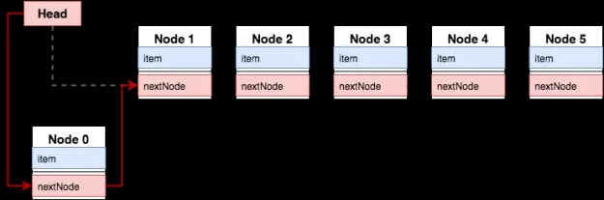
Case 1- Insertion at Beginning

Slide 89
Case 1- Insertion at Beginning
create the new node,
connect New Node to the OLD First NODE
Connect the Start Pointer to the new node,
……

Slide 90
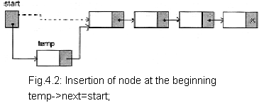
Case 1- Insertion at Beginning
Order?

Slide 91
Case 1- Insertion at Beginning
2
1
Order?

Slide 92
Case 1- Insertion at Beginning
Lets say tmp is the pointer which points to the node that has to be inserted
Assign data to the new node
tmp->info=data;
Start points to the first element of linked list
Assign the value of start to the link part of the inserted node as
tmp->link=start;
Now inserted node points beginning of the linked list.
To make the newly inserted node the first node of the linked list:
start=temp

Slide 93
Algorithm for Insertion at Beginning in a Linked List
First check whether Memory is available for the new node.
If the memory has exhausted then an Overflow message is printed
Else We allocate memory for the new node

Slide 94
Algorithm for Insertion at Beginning in a Linked List
Step 1:If AVAIL=NULL Then
WRITE OVERFLOW
Go to Step 7
[End of If]
Step 2: Set TEMP=AVAIL
Step 3: Set AVAIL=AVAIL->LINK Step 4: Set TEMP->INFO=DATA
Step 5: Set TEMP->LINK=START
Step 6 : Set START=TEMP
Step 7 :EXIT

Slide 95
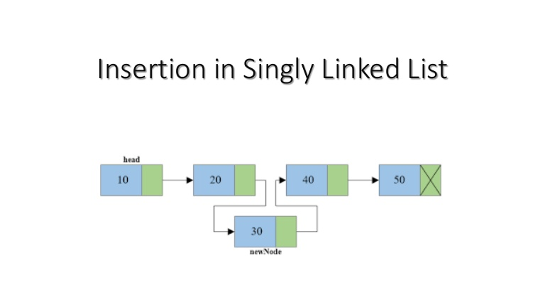
Case 2- Insertion in Between
Order?

Slide 96
Case 2- Insertion in Between
2
1
Order?

Slide 97
Case 2- Insertion in Between
create the New node ,
connect the nEW node to the next node
connect the previous to the new node,
……

Slide 98
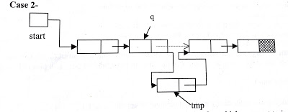
Case 2- Insertion in Between
First we traverse the linked list for obtaining the node after which we want to insert the element
q=start;
for(i=0;i<pos-1;i++)
{
q=q->link;
if(q==NULL)
{
printf("There are less than %d elements",pos);
return;
}
}/*End of for*/

Slide 99
Explanation-
q=start;
for(i=0;i<pos-1;i++)
{
q=q->link;
if(q==NULL)
{
printf("There are less than %d elements",pos);
return;
}
}/*End of for*/

Slide 100
Explanation-

Slide 101
Case 2- Insertion in Between
Then we add the new node by adjusting address fields
tmp->info=data;
tmp->link=q->link;
q->link=tmp;

Slide 102
Algorithm for Insertion in Between
Step 1:If AVAIL=NULL Then
WRITE OVERFLOW
Go to Step 13
[End of If]
Step 2: Set TEMP=AVAIL
Step 3: Set AVAIL=AVAIL->LINK Step 4: Set TEMP->INFO=DATA
Step 5: Set TEMP->LINK=NULL
Step 6 : Read POSITION from User
Step 7 : Set Q=START
Step 8 : Set I=0
Step 9 : Repeat step 10 till I<POS-1
Step 10: Set Q=Q->LINK
If Q=NULL Print Less Number of Elements
Exit
[ End of If ]
SET I=I+1
[End of Loop]
Step 11:Set TEMP->LINK=Q->LINK
Step 12:Set Q->LINK=TEMP
Step 13:Exit
Step 7 :EXIT
q=start;
for(i=0;i<pos-1;i++)
{
q=q->link;
if(q==NULL)
{
printf("There are less than %d elements",pos);
return;
}
}/*End of for*/

Slide 103
Case 3- Insertion at the end
Without Using Position ?
At the end?

Slide 104
Case 3- Insertion at the end
Then we add the new node by adjusting address fields
tmp->info=data;
tmp->link=NULL;
q->link=tmp;

Slide 105
Algorithm for Insertion at the end of a Linked List
Step 1: If AVAIL=NULL Then
WRITE OVERFLOW
Go to Step 10
[End of If]
Step 2: Set TEMP=AVAIL
Step 3: Set AVAIL=AVAIL->LINK Step 4: Set TEMP->INFO=DATA
Step 5: Set TEMP->LINK=NULL
Step 6 : Set Q=START
Step 7 : Repeat step 8 while Q->LINK!=NULL
Step 8: SET Q=Q->LINK
[End of Loop]
Step 9 : SET Q->LINK=TEMP
Step 10 : EXIT

Slide 106
Deletion from a Linked List
For deleting the node from a linked list, first we traverse the linked list and compare with each element.
After finding the element there may be two cases for deletion-
Deletion in beginning
Deletion in between

Slide 107
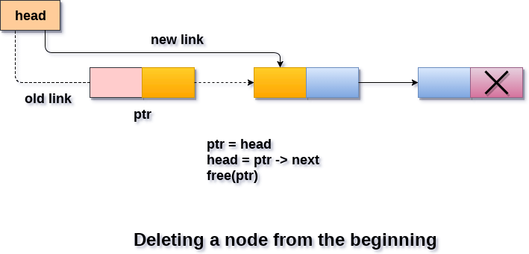
Deletion in beginning

Slide 108
Deletion in beginning
connect
Start Pointer to the second node……
Delete the First node

Slide 109
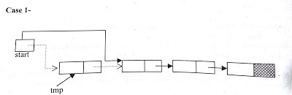
Deletion in beginning
Start points to the first element of linked list.
If element to be deleted is the first element of linked list then we assign the value of start to tmp as-
tmp = start;
So tmp points to the first node which has to be deleted.
Now assign the link part of the deleted node to start as-
start=start->link;
Since start points to the first element of linked list, so start->link will point to the second element of linked list.
Now we should free the element to be deleted which is pointed by tmp. free( tmp );

Slide 110
Algorithm for Deletion in the beginning of the Linked List
Step 1:If START=NULL
Step 2: Write UNDERFLOW
Step 3: Go to Step 7
[End of If]
Step 4: Set TEMP=START
Step 5: Set START=START->LINK
Step 6:FREE TEMP
Step 7:EXIT

Slide 111
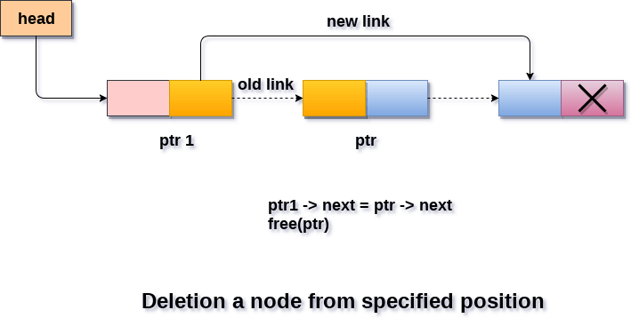
Deletion in between

Slide 112
Deletion in between
1)connect
the previous and the next node……
2)Delete the node

Slide 113
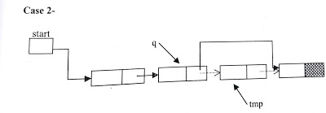
Deletion in between

Slide 114
Deletion in between
If the element is other than the first element of linked list then
we give the link part of the node to be deleted to the link part of the previous node.
This can be as-
tmp =q->link;
q->link = tmp->link;
free(tmp);

Slide 115
Deletion at the end
If node to be deleted is last node of linked list then statement 2 will be as-
tmp =q->link;
q->link = NULL;
free(tmp);

Slide 116
Circular Linked List

Slide 117
Why Circular?
In a singly linked list,
If we are at any node in the middle of the list, then it is not possible to access nodes that precede the given node.
This problem can be solved by slightly altering the structure of singly linked list.

Slide 118
How?
In a singly linked list, next part (pointer to next node) of the last node is NULL,
if we utilize this link to point to the first node then we can reach preceding nodes.

Slide 119
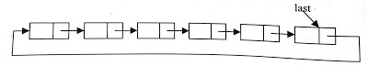
Implementation of circular linked list
Creation of circular linked list is same as single linked list.
Last node will always point to first node instead of NULL.

Slide 120
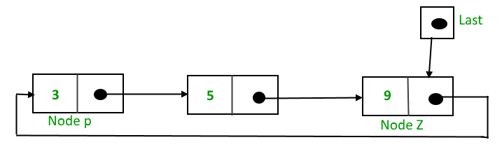
Implementation of circular linked list
One pointer last,
Last points to last node of list and
Link part of Last node points to the first node of list.

Slide 121
Advantages of a Circular linked list
In circular linked list, we can easily traverse to its previous node, which is not possible in singly linked list.
Entire list can be traversed from any node.
If we are at a node, then we can go to any node. But in linear linked list it is not possible to go to previous node.

Slide 122
Advantages of a Circular linked list
In Single Linked List, for insertion at the end, the whole list has to be traversed.
In Circular Linked list,
with pointer to the last node there won’t be any need to traverse the whole list.
So insertion in the begging or at the end takes constant time irrespective of the length of the list i.e O(1).
It saves time when we have to go to the first node from the last node.
It can be done in single step because there is no need to traverse the in between nodes

Slide 123
Disadvantages of Circular linked list
Circular list are complex
as compared to singly linked lists.
Reversing of circular list is complex
as compared to singly or doubly lists.
If not traversed carefully,
then we could end up in an infinite loop.
Like singly and doubly lists circular linked lists also doesn’t supports direct accessing of elements.

Slide 124
Insertion into a circular linked list :-
Insertion in a circular linked list may be possible in two ways-
Insertion in an empty list
Insertion at the end of the list
Insertion at beginning
Insertion in between

Slide 125
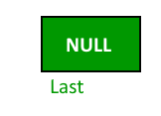
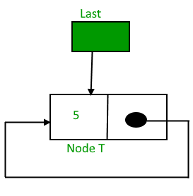
Insertion in an empty list
New element can be added as-
If linked list is empty:
If (last==NULL)
{
last=tmp;
tmp->link=last
}

Slide 126
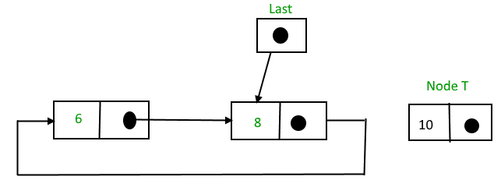
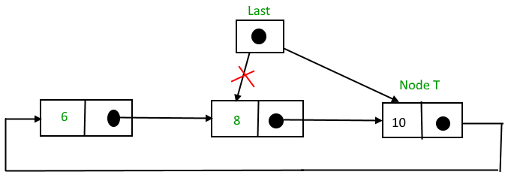
Insertion at the end of circular linked list
If linked list is not empty:
Insertion at the end of the list
{
tmp->link = last->link; /* added at the end of list*/
last->link = tmp;
last = tmp;
}
Last pointer shifted
Temp
3
2
1

Slide 127
Insertion at the end of circular linked list
If linked list is not empty:
Insertion at the end of the list
{
tmp->link = last->link; /* added at the end of list*/
last->link = tmp;
last = tmp;
}
Last pointer shifted
3
2
1

Slide 128
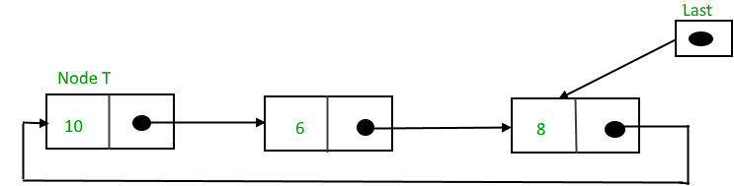
Insertion at the beginning of circular linked list
Last pointer not shifted !!
Temp
1
2

Slide 129
Insertion at the beginning of circular linked list
Insertion at the beginning of the list Follow these step: 1. Create a node, say tmp. 2. Make tmp-> next = last -> next. 3. last -> next = tmp.
Last pointer not shifted !!
Temp
1
2

Slide 130
Insertion at the beginning of circular linked list
Insertion at the beginning of the list Follow these step: 1. Create a node, say tmp. 2. Make tmp-> next = last -> next. 3. last -> next = tmp.
Last pointer not shifted !!
1
2

Slide 131
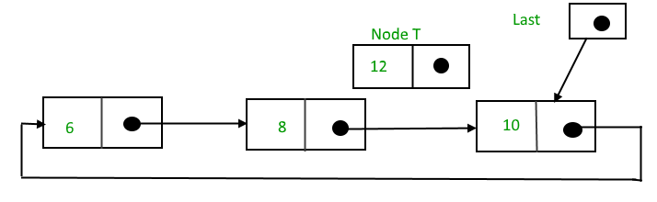
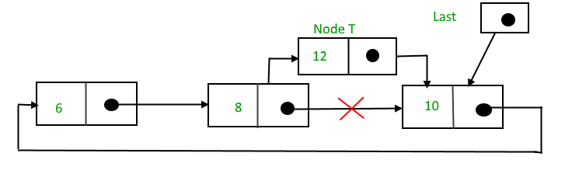
Insertion in between of circular linked list
Insertion in between is same as in single linked list. This can be as-
tmp->link = q->link;
tmp->info = num;
q->link =tmp;
Here q points to the node after which new node will be inserted.

Slide 132
Insertion in between of circular linked list
Insertion in between is same as in single linked list. This can be as-
tmp->link = q->link;
tmp->info = num;
q->link =tmp;
Here q points to the node after which new node will be inserted.

Slide 133
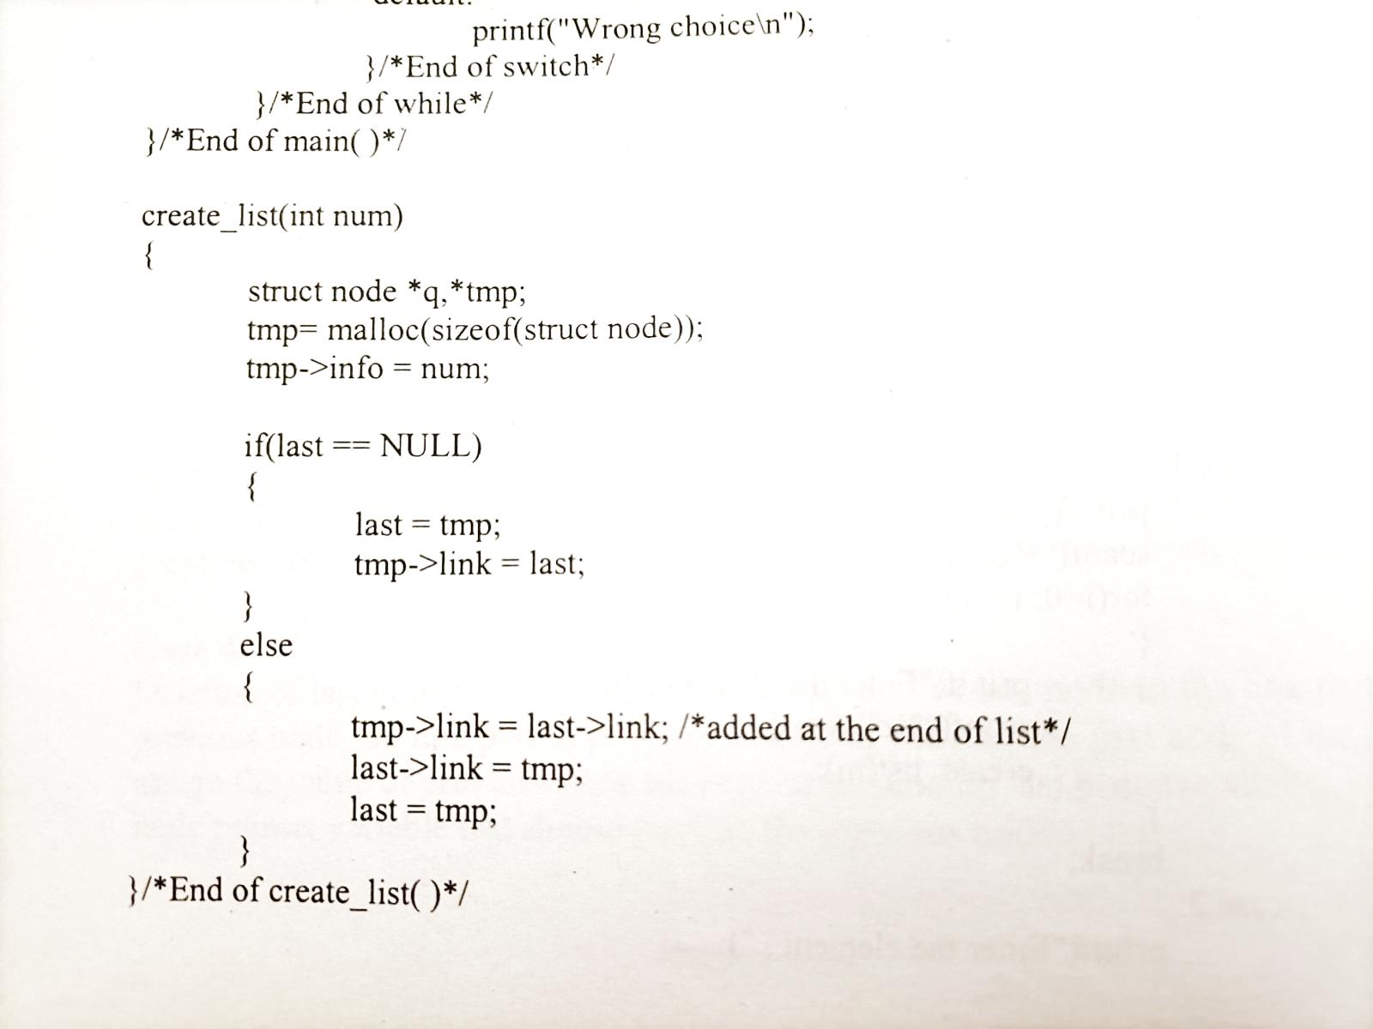
Creation of CLL
Case:CLL is Empty

Slide 134
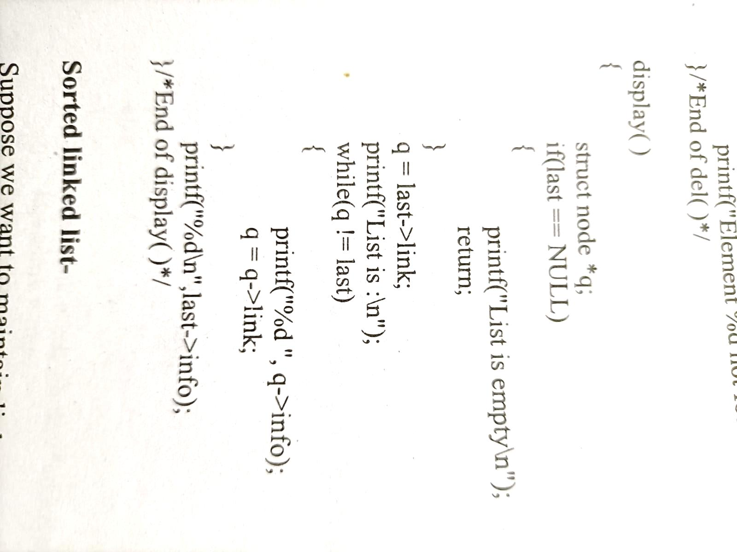
Traversal of circular linked list

Slide 135
Deletion from a circular linked list :-
Deletion in a circular linked list may be possible in four ways-
If list has only one element
Node to be deleted is the first node of list
Deletion in between
Node to be deleted is last node of list

Slide 136
Deletion from a circular linked list :-
Case 1:- If list has only one element
Here we check the condition for only one element of list
then assign NULL value to last pointer because after deletion no node will be in list.
if(last->link == last && last->info == num) /* Only one element */
{
tmp = last;
last = NULL;
free(tmp);
}

Slide 137
Deletion from a circular linked list :-
Case 1:- If list has only one element
Here we check the condition for only one element of list
then assign NULL value to last pointer because after deletion no node will be in list.
if(last->link == last && last->info == num) /* Only one element */
{
tmp = last;
last = NULL;
free(tmp);
}

Slide 138
Deletion from a circular linked list :-
Case 2:- Node to be deleted is the first node of list
Assign the link part of deleted node to the link part of pointer last.
So now link part of last pointer will point to the next node which is now first node of list after deletion.
q = last->link; /*q is pointing to the first node of list*/
if(q->info == num)
{
tmp = q;
last->link = q->link;
free(tmp);
}

Slide 139
Deletion from a circular linked list :-
Case 2:- Node to be deleted is the first node of list
Assign the link part of deleted node to the link part of pointer last.
So now link part of last pointer will point to the next node which is now first node of list after deletion.
q = last->link; /*q is pointing to the first node of list*/
if(q->info == num)
{
tmp = q;
last->link = q->link;
free(tmp);
}

Slide 140
Deletion from a circular linked list :-
Case 3:- Deletion in between is same as in single linked list.
Deletion of node in between will be as-
q = last->link;
while(q->link != last)
{
if(q->link->info == num) /* Element deleted in between */
{
tmp = q->link;
q->link = tmp->link;
free(tmp);
}
q = q->link;
} /* End of while */
First we are traversing the list, when we find the element to be deleted,
then q points to the previous node.
We assign the link part of node to be deleted to the link part of previous node and
then we free the address of node to be deleted from memory.
As we need to stop at the previous node for deletion

Slide 141
Same as Deletion in between in Singly Linked List
If the element is other than the first element of linked list then
we give the link part of the deleted node to the link part of the previous node.
This can be as-
tmp =q->link;
q->link = tmp->link;
free(tmp);

Slide 142
Deletion from a circular linked list :-
Case 4:- Deletion of last node
Assign the link part of last node to the link part of previous node.
So link part of previous node will point to the first node of list.
Then assign the value of previous node to the pointer variable last because after deletion of last node , pointer variable last should point to the previous node.
tmp = q->link;
q->link = last->link;
free(tmp);
last =q;
q

Slide 143
Doubly Linked List

Slide 144
Doubly Linked List
Drawback of single linked list-
In single linked list,
we can traverse only in one direction because each node has address of next node only.
Suppose we are in the middle of singly linked list and
To do operation with just previous node then we have no way to go on previous node,
We will again traverse from starting node.

Slide 145
Doubly Linked List
Drawback of single linked list-
Solution-
Doubly linked list, in this each node has address of both previous and next node.

Slide 146
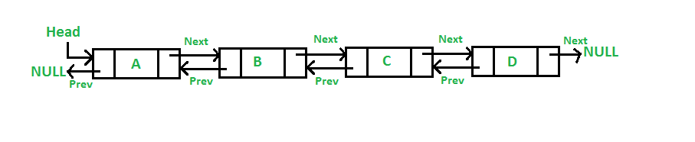
Doubly Linked List

Slide 147
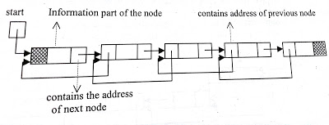
Doubly Linked List
The data structure for doubly linked list will be as-
struct node
{
struct node *prev;
int info;
struct node *next;
}*start;

Slide 148
Doubly Linked List
struct node
{
struct node *prev;
int info;
struct node *next;
}*start;
struct node *previous is a pointer to structure, which will contain the address of previous node
struct node * next will contain the address of next node in the list.
Traversal in both directions at any time.

Slide 149
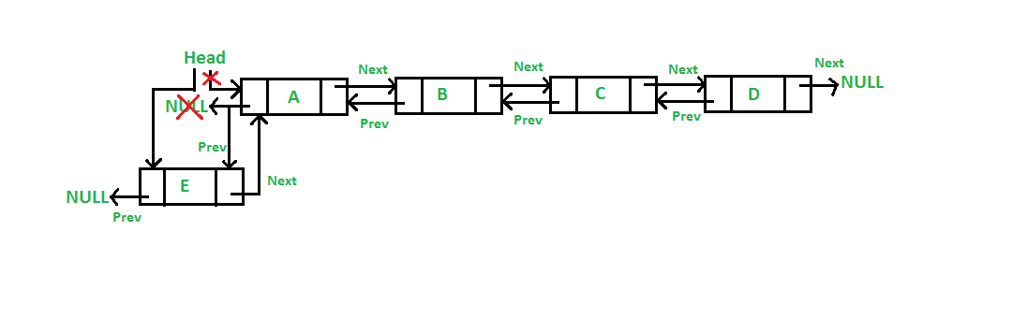
Doubly Linked List-Insertion at beginning
A 5 steps process

Slide 150
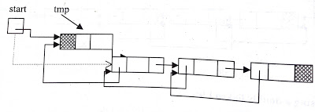
Doubly Linked List-Insertion at beginning
Start points to the first node of doubly linked list.
Assign the value of start to the next part of inserted node and address of inserted node to the prev part of start as-
tmp->next=start;
tmp->info=data
start->prev = tmp;
Now inserted node points to the next node, which was beginning node of the doubly linked list and
prev part of second node will point to the new inserted node. Now inserted node is the first node of the doubly linked list.

Slide 151
Doubly Linked List-Insertion at beginning
So start will be reassigned as-
start= tmp;
Now start will point to the inserted node which is first node of the doubly linked list.
Assign NULL to prev part of inserted node since now it will become the first node and prev part of first node is NULL-
tmp->prev=NULL;

Slide 152
Doubly Linked List-Insertion at beginning
tmp->next=start;
tmp->info=data
start->prev = tmp;
start= tmp;
tmp->prev=NULL;

Slide 153
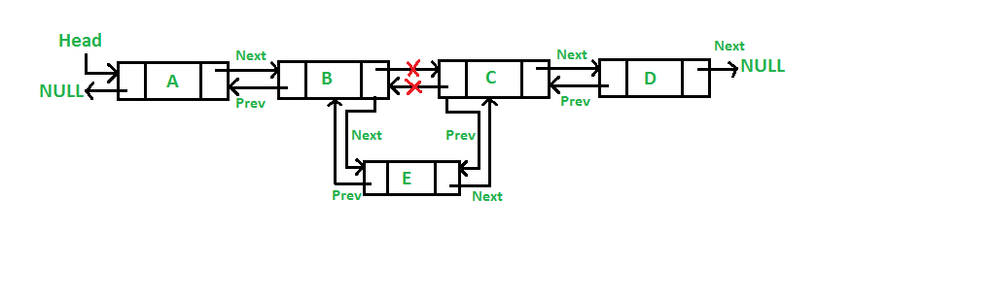
Doubly Linked List-Insertion in between

Slide 154
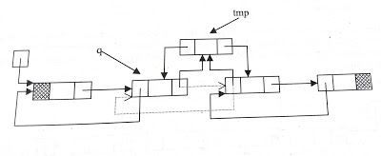
Doubly Linked List-Insertion in between
Traverse to obtain the node (q) after which we want to insert the element.
Assign the address of inserted node(tmp) to the prev part of next node.
q->next->prev=tmp;
1

Slide 155
Doubly Linked List-Insertion in between
Assign the next part of previous node to the next part of inserted node.
tmp->next=q->next;
2
1

Slide 156
Doubly Linked List-Insertion in between
Address of previous node will be assigned to prev part of inserted node
tmp->prev=q;
2
3
1

Slide 157
Doubly Linked List-Insertion in between
Address of inserted node will be assigned to next part of previous node.
q->next=tmp;
2
3
4
1

Slide 158
Doubly Linked List-Insertion in between
Traverse to obtain the node (q) after which we want to insert the element.
Assign the address of inserted node(tmp) to the prev part of next node.
q->next->prev=tmp;
Assign the next part of previous node to the next part of inserted node.
tmp->next=q->next;
Address of previous node will be assigned to prev part of inserted node
tmp->prev=q;
Address of inserted node will be assigned to next part of previous node.
q->next=tmp;

Slide 159
Doubly Linked List-Insertion at the last
Traverse to obtain the node (q) after which we want to insert the element.
tmp->next=NULL;
Address of previous node will be assigned to prev part of inserted node
tmp->prev=q;
q
temp
1
prev |  | next

Slide 160
Doubly Linked List-Insertion at the last
Address of inserted node will be assigned to next part of previous node.
q->next=tmp;
q
temp
1
prev |  | next
2

Slide 161
Doubly Linked List-Insertion at the last
tmp->next=NULL;
tmp->prev=q;
q->next=tmp;
q
temp
1
prev |  | next

Slide 162
Deletion from doubly linked list
Traverse the linked list and compare with each element. After finding the element there may be three cases for deletion-
Deletion at beginning
Deletion in between
Deletion of last node

Slide 163
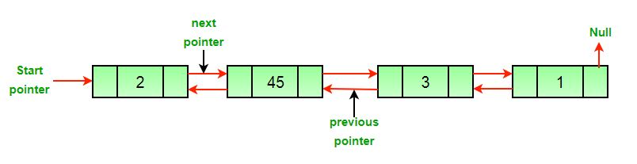
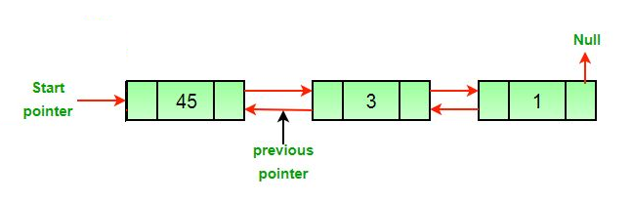
Deletion from doubly linked list-Deletion at beginning

Slide 164
Doubly linked list-Deletion at beginning
Assign the value of start to tmp as-
tmp = start;
Now we assign the next part of deleted node to start as-
start=start->next;
Since start points to the first node of linked list, so start->next will point to the second node of list.
Then NULL will be assigned to start->prev.
start->prev = NULL;
Now we should free the node to be deleted which is pointed by tmp.
free( tmp );

Slide 165
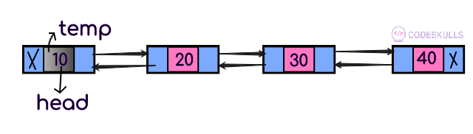
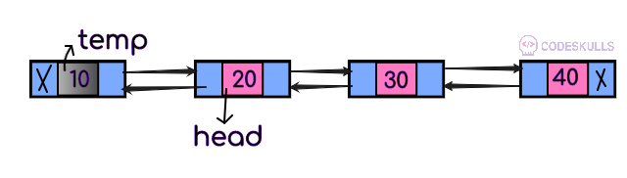
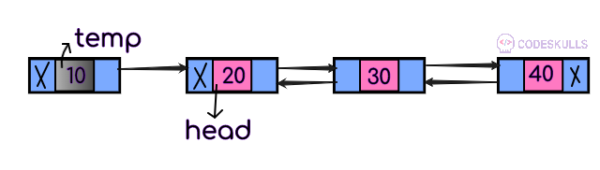
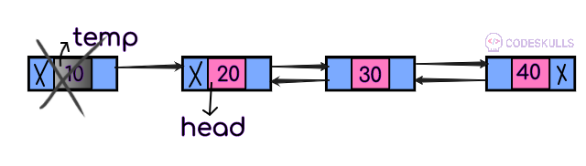
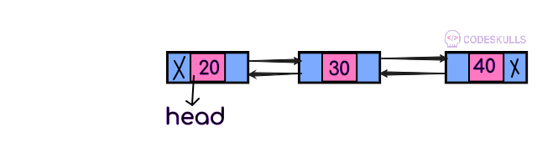
Doubly linked list-Deletion at beginning
1
Assign the value of start to tmp as-
1)tmp = start;

Slide 166
Doubly linked list-Deletion at beginning
1
Now we assign the next part of deleted node to start as-
2)start=start->next;
2

Slide 167
Doubly linked list-Deletion at beginning
1
Since start points to the first node of linked list, so start->next will point to the second node of list.
Then NULL will be assigned to start->prev.
3)start->prev = NULL;
2
3

Slide 168
Doubly linked list-Deletion at beginning
1
Now we should free the node to be deleted which is pointed by tmp.
4)free( tmp );
2
3
4

Slide 169
Doubly linked list-Deletion at beginning
Assign the value of start to tmp as-
1)tmp = start;
Now we assign the next part of deleted node to start as-
2)start=start->next;
Since start points to the first node of linked list, so start->next will point to the second node of list.
Then NULL will be assigned to start->prev.
3)start->prev = NULL;
Now we should free the node to be deleted which is pointed by tmp.
4)free( tmp );

Slide 170

Deletion from doubly linked list-Deletion in between
Concept-
We assign the next part of the deleted node to the next part of the previous node
address of the previous node to prev part of next node.

Slide 171
Deletion from doubly linked list-Deletion in between
tmp=q->next;
Here q is pointing to the previous node of node to be deleted.
After statement 1 tmp will point to the node to be deleted.
1

Slide 172
Deletion from doubly linked list-Deletion in between
tmp=q->next;
q->next=tmp->next;
After statement 2 next part of previous node will point to next node of the node to be deleted
2
1

Slide 173
Deletion from doubly linked list-Deletion in between
tmp=q->next;
q->next=tmp->next;
tmp->next->prev=q;
After statement 3 prev part of next node will point to previous node.
1
3
2
1

Slide 174
Deletion from doubly linked list-Deletion in between
tmp=q->next;
q->next=tmp->next;
tmp->next->prev=q;
free(tmp);
Here q is pointing to the previous node of node to be deleted.
After statement 1 tmp will point to the node to be deleted.
After statement 2 next part of previous node will point to next node of the node to be deleted
After statement 3 prev part of next node will point to previous node.

Slide 175
Doubly linked list-Deletion of last node
Concept-
If node to be deleted is last node of doubly linked list then
we will just free the last node

Slide 176




Doubly linked list-Deletion of last node
1
1) tmp=q->next;
Here q is second last node
After statement 1, tmp will point to last node

Slide 177
Doubly linked list-Deletion of last node
1
2) free(tmp);
After statement 2, last node will be deleted
2

Slide 178
Doubly linked list-Deletion of last node
1
Next part of second last node i.e q will be NULL.
3) q->next=NULL;
2
3

Slide 179
Doubly linked list-Deletion of last node
If node to be deleted is last node of doubly linked list then
we will just free the last node and
tmp=q->next;
free(tmp);
next part of second last node will be NULL.
q->next=NULL;
Here q is second last node
After statement 1, tmp will point to last node
After statement 2 last node will be deleted and after statement 3 second last node will become the last node of list.

Slide 180
Application of Linked List
Polynomial Representation and Addition

Slide 181
Polynomial arithmetic with linked list
Linked list can be used
to represent polynomial expression
for arithmetic operations also.

Slide 182
Representation of Polynomial
Let us take a polynomial expression-
5x⁴ + x³ - 6x + 2

Slide 183
Representation of Polynomial
Let us take a polynomial expression-
5x⁴ + x³ - 6x + 2
Here we can see every symbol x is attached with two things,
coefficient
exponent.

Slide 184

Representation of Polynomial
As in 5x⁴ , coefficient is 5 and exponent is 4.
5x⁴ + x³ - 6x + 2
Each node of list will contain the coefficient and exponent of each term of polynomial expression.

Slide 185
Representation of Polynomial
So the data structure for polynomial expression will be-
struct node{
int coefficient;
int exponent;
struct node *link;
}

Slide 186
Descending sorted linked list is used based on the exponent
As it will be easier for arithmetic operation with polynomial linked list.
Otherwise, we have a need to traverse the full list for every arithmetic operation.

Slide 187

Now we can represent polynomial expression
5x⁴ + x³ - 6x + 2 as-

Slide 188
Creation of polynomial linked list
Creation of polynomial linked list will be same as
creation of sorted linked list but
it be in descending order and based on exponent of symbol.

Slide 189
Creation of polynomial linked list
Insertion at the Start
In if condition we are checking for the node to be added will be first node or not.
/* list empty or exp greater than first one */
if(start==NULL || ex> start->expo)
{
tmp->link=start;
start=tmp;
return start;
}

Slide 190
Creation of polynomial linked list
else
{
ptr=start;
while(ptr->link!=NULL && ptr->link->expo > ex)
{
ptr=ptr->link;
}
tmp->link=ptr->link;
ptr->link=tmp;
if(ptr->link==NULL) /* item to be added in the end */
tmp->link=NULL;
}
Lets insert 9x²
Let ex=2
Ptr=1st Node
Check if ptr->link->expo > ex
Check if 2nd node’s expo >ex
If 3>2, yes
Then
Ptr=ptr->link
Ptr=2nd node
Check if ptr->link->expo>ex
Check if 3rd node’s expo>ex
If 1>2, no
Insert the new node here
9 | 2

Slide 191
Creation of polynomial linked list
else
{
ptr=start;
while(ptr->link!=NULL && ptr->link->expo > ex)
{
ptr=ptr->link;
}
tmp->link=ptr->link;
ptr->link=tmp;
if(ptr->link==NULL) /* item to be added in the end */
tmp->link=NULL;
}
In else part
we traverse the list and
check the condition for exponent then
we add the node at proper place in list.
If node will be added at the end of list then
we assign NULL in link part of added node.

Slide 192
Addition with polynomial linked list
Input :
p1= 13x⁸ + 7x⁵ + 32x² + 54
p2= 3x¹² + 17x⁵ + 3x³ + 98
Output : 3x¹² + 13x⁸ + 24x⁵ + 3x³ + 32x² + 152

Slide 193
Addition with polynomial linked list
For addition of two polynomial linked list, we have a need to traverse the nodes of both the lists.
If the node has exponent value higher than another, then
that node will be added to the resultant list
or
Nodes which have unique exponent values in both the lists will be added in the resultant list.

Slide 194
Addition with polynomial linked list
If the nodes have same exponent value then
first the coefficient of both nodes will be added
then the result will be added to the resultant list.

Slide 195

Addition with polynomial linked list
Suppose in traversing one list is finished then
remaining node of the another list will be added to the resultant list.

